Slide 1
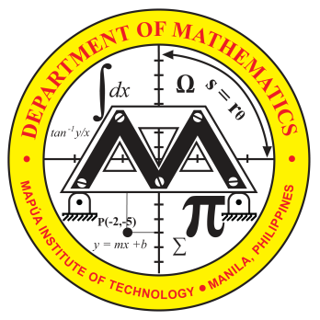

ROTATION OF AXIS
Math 14
Plane and Solid Analytic Geometry

Slide 2
OBJECTIVES:
At the end of the lesson, the student is expected to be able to:
• transform an equation by rotation of axes.
• simplify the equations by rotation of axes.
• identify a conic given an equation.
• graph the transformed equation.

Slide 3
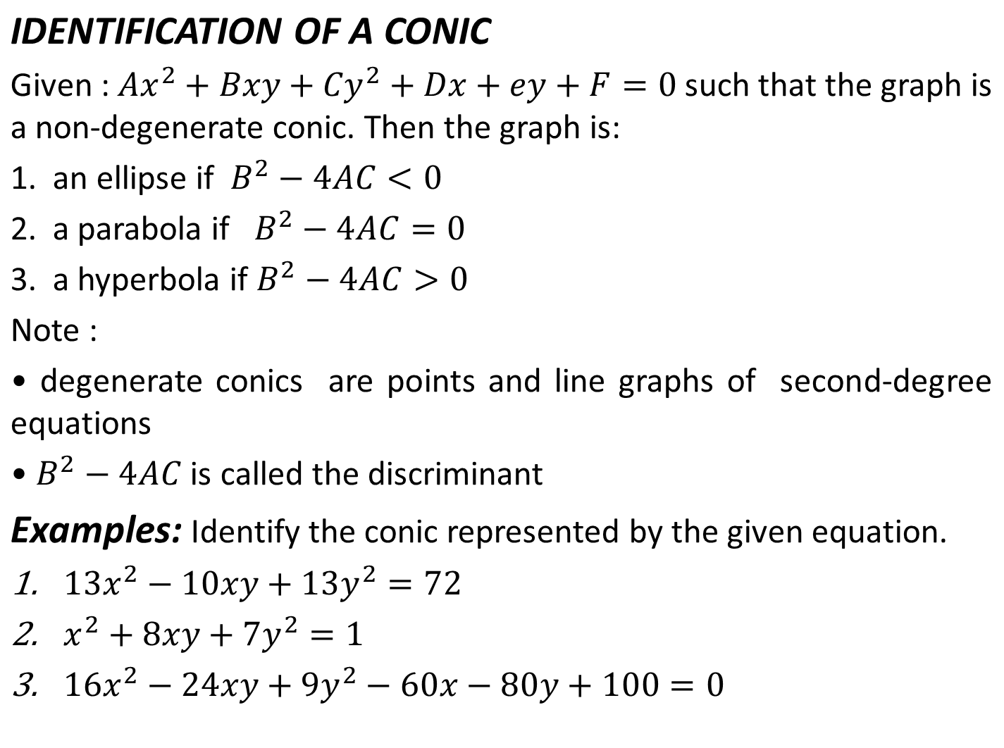
Ey

Slide 4
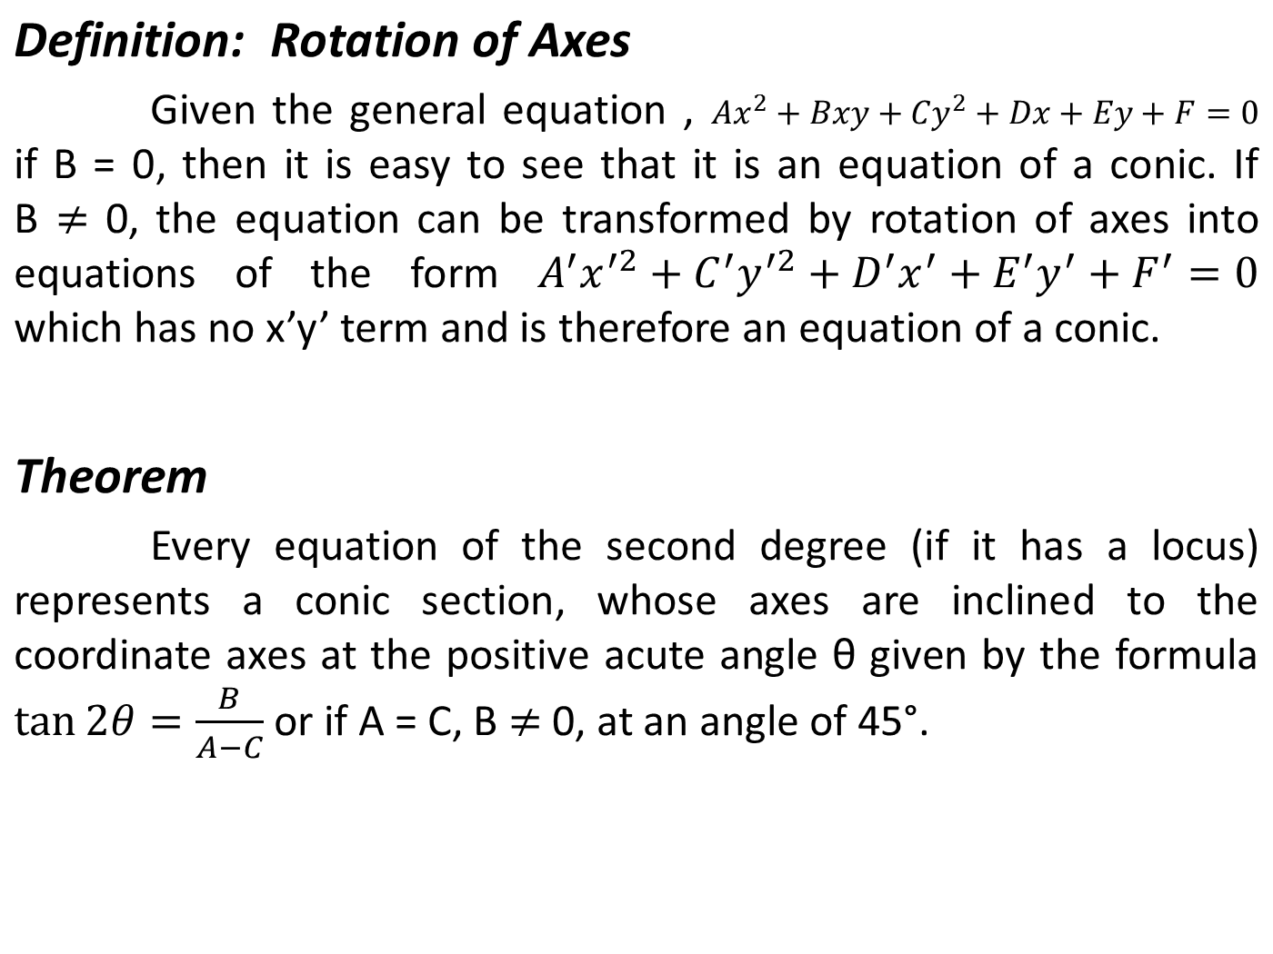

Slide 5
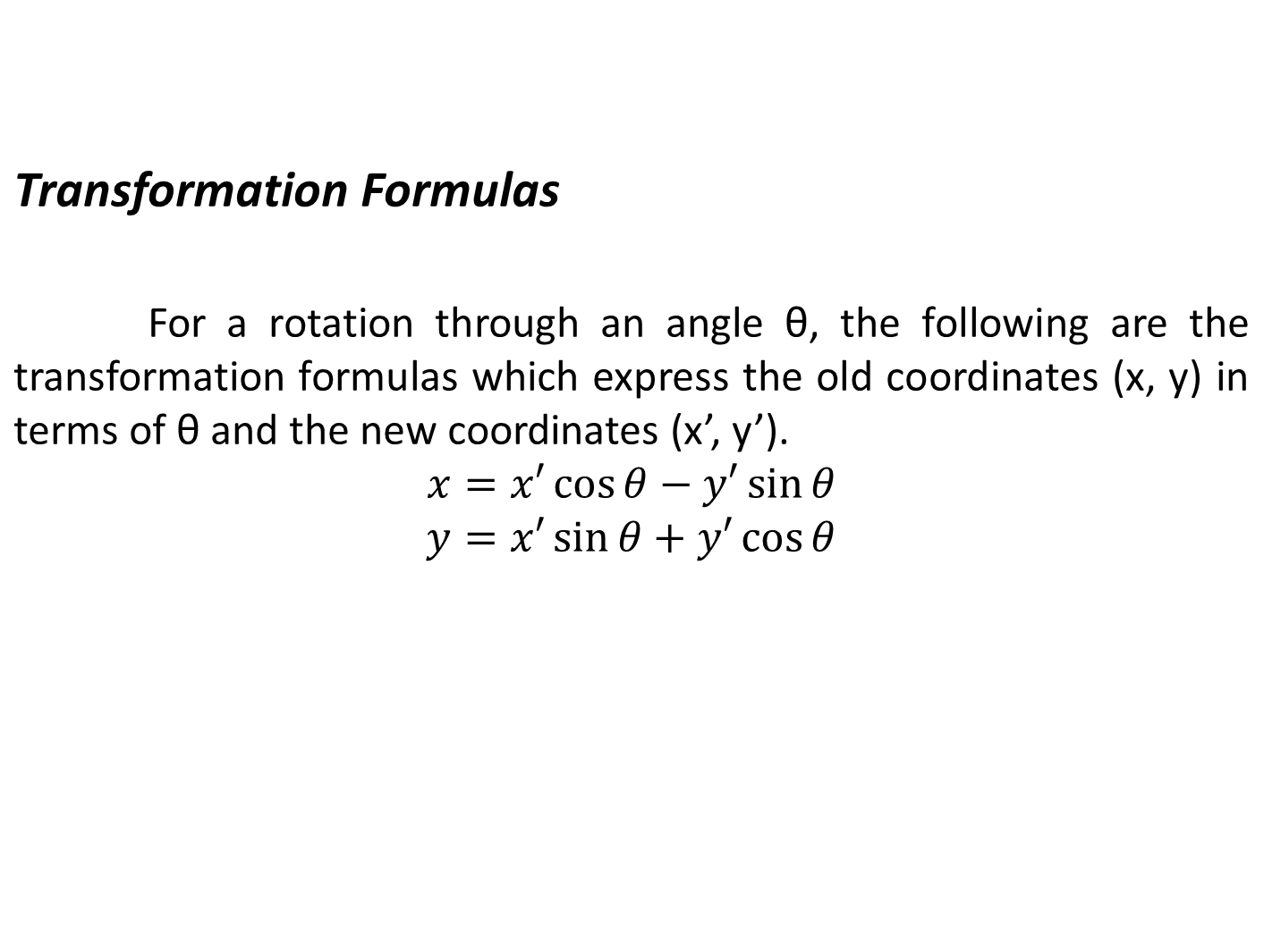

Slide 6
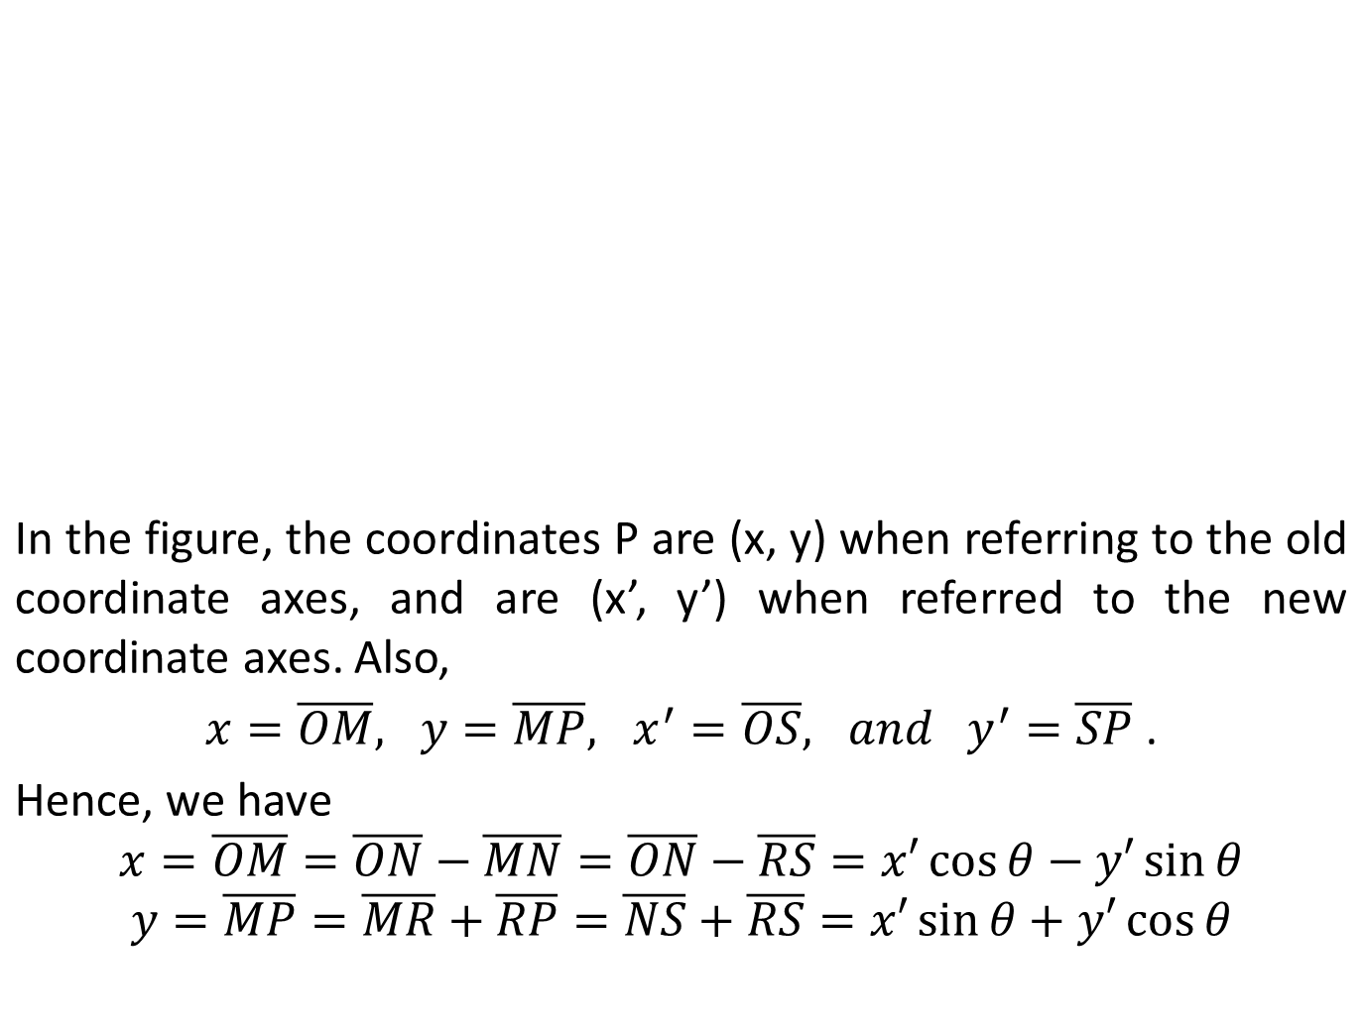
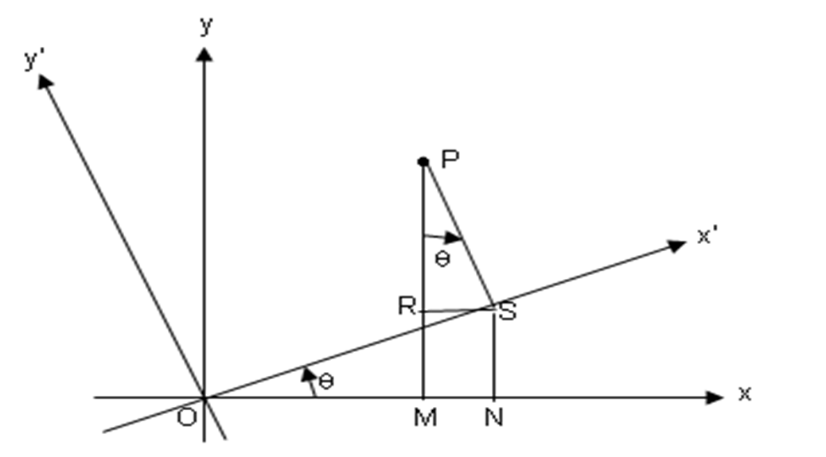
RP

Slide 7
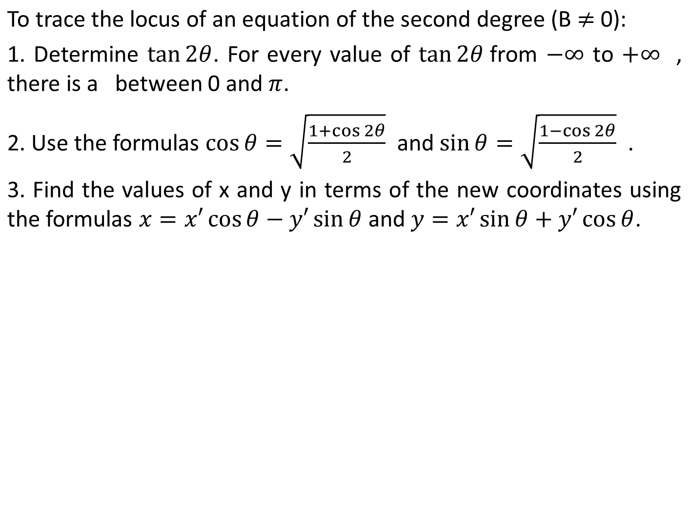
2θ
REFERENCES
Analytic Geometry

Slide 8
